Slide 1


CUSTOMER RETENTION ANALYSIS

Slide 2
Project Background
As part of my internship at PWC, I am working on analyzing customer retention data. The main objective of this analysis is to understand the reasons behind the reduction in revenue and to assess the level of customer interest in our service. I am also investigating if customers are churning and why, and suggesting necessary steps to prevent it. To do this, I am examining the trends of how customers are switching to other products and what motivates them. Based on my findings, I will provide recommendations on how to improve our customer retention.

Slide 3
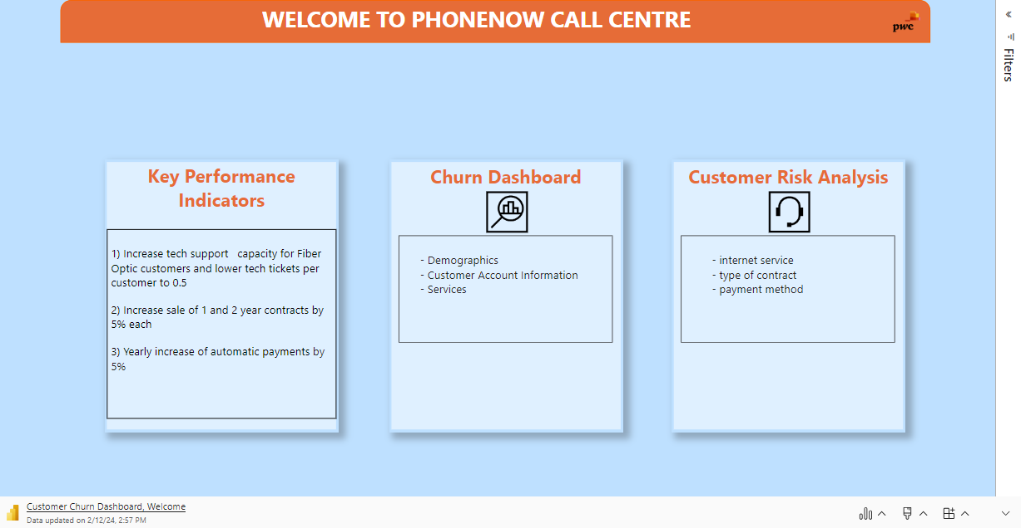

Slide 4
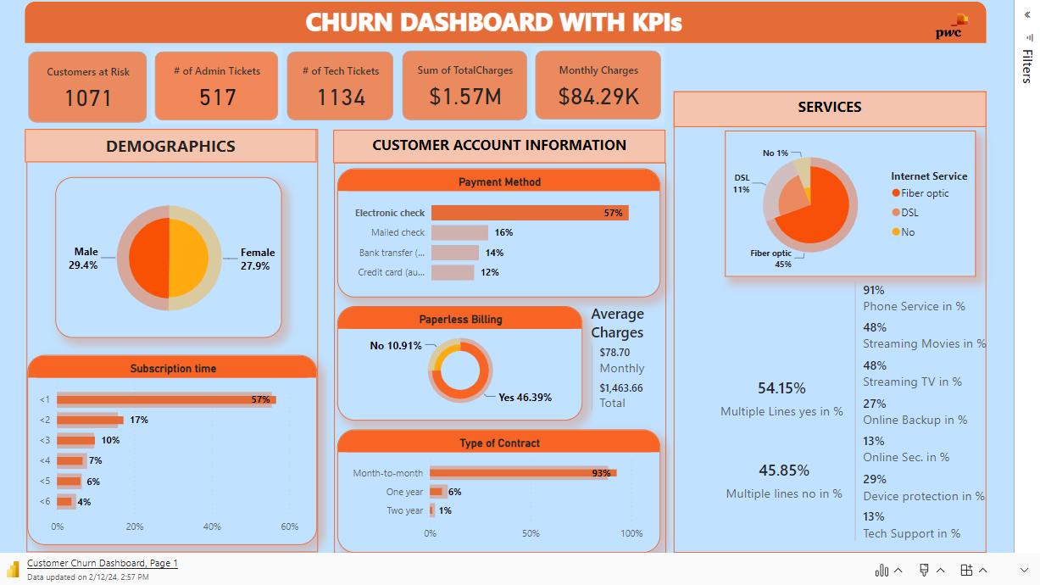

Slide 5
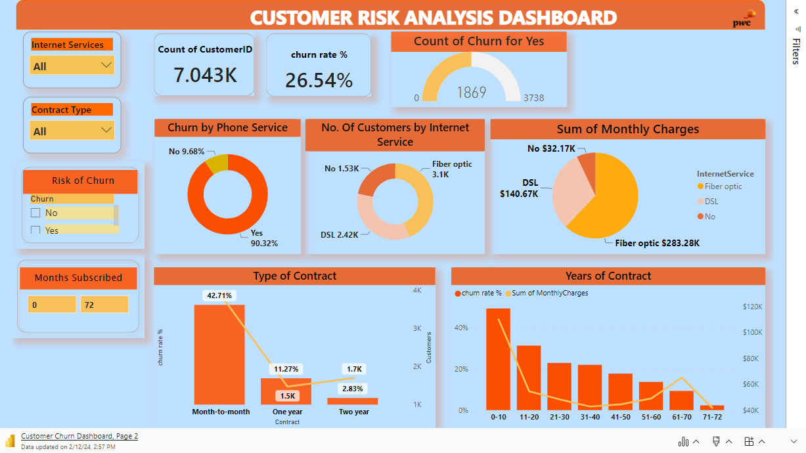

Slide 6
CUSTOMER RETENTION DASHBOARD REPORT
Overview
This report provides an analysis of the customer churn for the company, based on the data from the Churn Dashboard. The report covers the following aspects:
Total number of customers and churn rate.
Distribution of customers by demographics, account information, and services.
Relationship between churn rate and other factors, such as monthly charges, contract type, and internet service.
The report also offers some recommendations for reducing the customer churn and increasing the customer loyalty.

Slide 7
Key Findings
The company has 7,043 customers, with a churn rate of 26.54%.
The majority of customers (90.32%) are not at risk of churning, while 9.68% are at risk.
The customer base is almost evenly split between males (49.8%) and females (50.2%).
Most customers (55%) have a subscription time of more than one year, while 45% have less than one year.
Most customers (89%) have a month-to-month contract, followed by one year (7%) and two year (4%) contracts.
Most customers (57%) prefer electronic check as their payment method, followed by mailed check (16%), bank transfer (14%), and credit card (12%).
Nearly three-quarters of the customer base (74.91%) opt for paperless billing.
Most customers (96.86%) have a phone service, while 3.14% do not.

Slide 8
The most popular internet service is fiber optic (63%), followed by DSL (25%). Some customers (6%) have no internet service.
The monthly charges vary by the type of internet service, with fiber optic being the most expensive ($238.28K), followed by DSL ($140.67K) and no service ($32.17K).
The churn rate and the monthly charges have a positive correlation with the contract type, meaning that the customers with month-to-month contracts have higher churn rates and monthly charges than those with longer contracts.
The churn rate also has a positive correlation with the internet service, meaning that the customers with fiber optic service have higher churn rates than those with DSL or no service.
The customers at risk of churning have raised more admin tickets (885) and tech tickets (2173) than the customers not at risk.

Slide 9
Conclusion
The Churn Dashboard provides a comprehensive overview of the customer churn for the company. It indicates that there are some areas of improvement, such as the contract type, the payment method, the internet service, the monthly charges, and the customer service. By implementing the recommendations suggested in this report, the company can reduce the customer churn and increase the customer loyalty.

